Slide 1
Git CICD Maven Jenkins

Slide 2
Agenda
1. Introduction
2. Getting Started With Jenkins
3. CI & CD Pipeline with Jenkins & Maven (30 mins Hands-on)
4.Git Basics
5. Setting Up Github
6.Working with Local & remote repositories (30 mins Hands-on)
7. Continuous Integration & Continuous Delivery with Jenkins (30 mins Hands-on),
Managing and Monitoring Jenkins
8. Any enterprise case study to understand the big picture

Slide 3
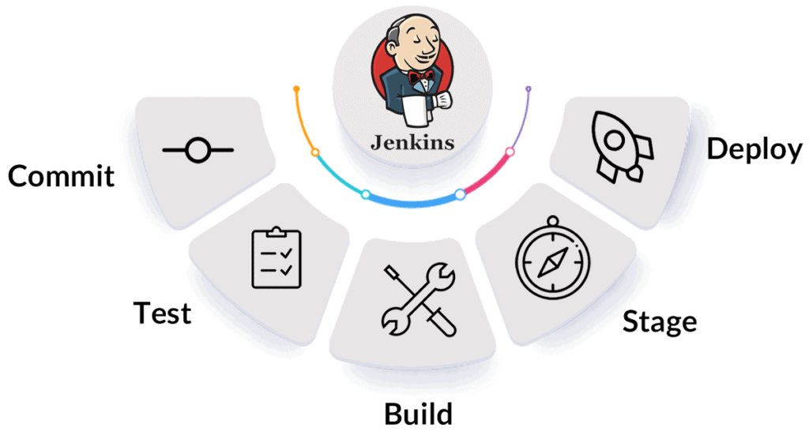
What is Jenkins

Slide 4
Jenkins
Jenkins is an open-source automation tool for Continuous Integration (CI) and Continuous Deployment (CD).
It is a server-based system that runs in servlet containers like Apache Tomcat. Jenkins is one of the most used DevOps tools along with other cloud-native tools and allows developers to build, test and deploy software seamlessly.

Slide 5
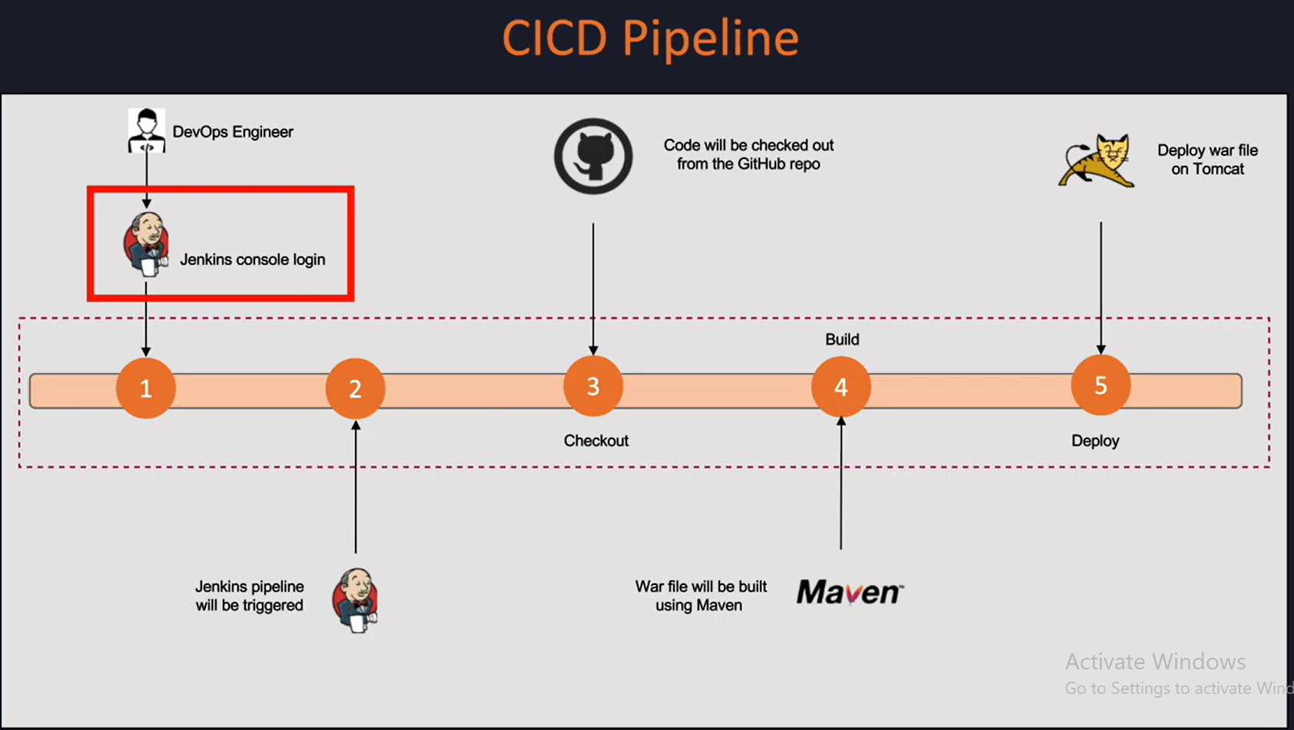

Slide 6
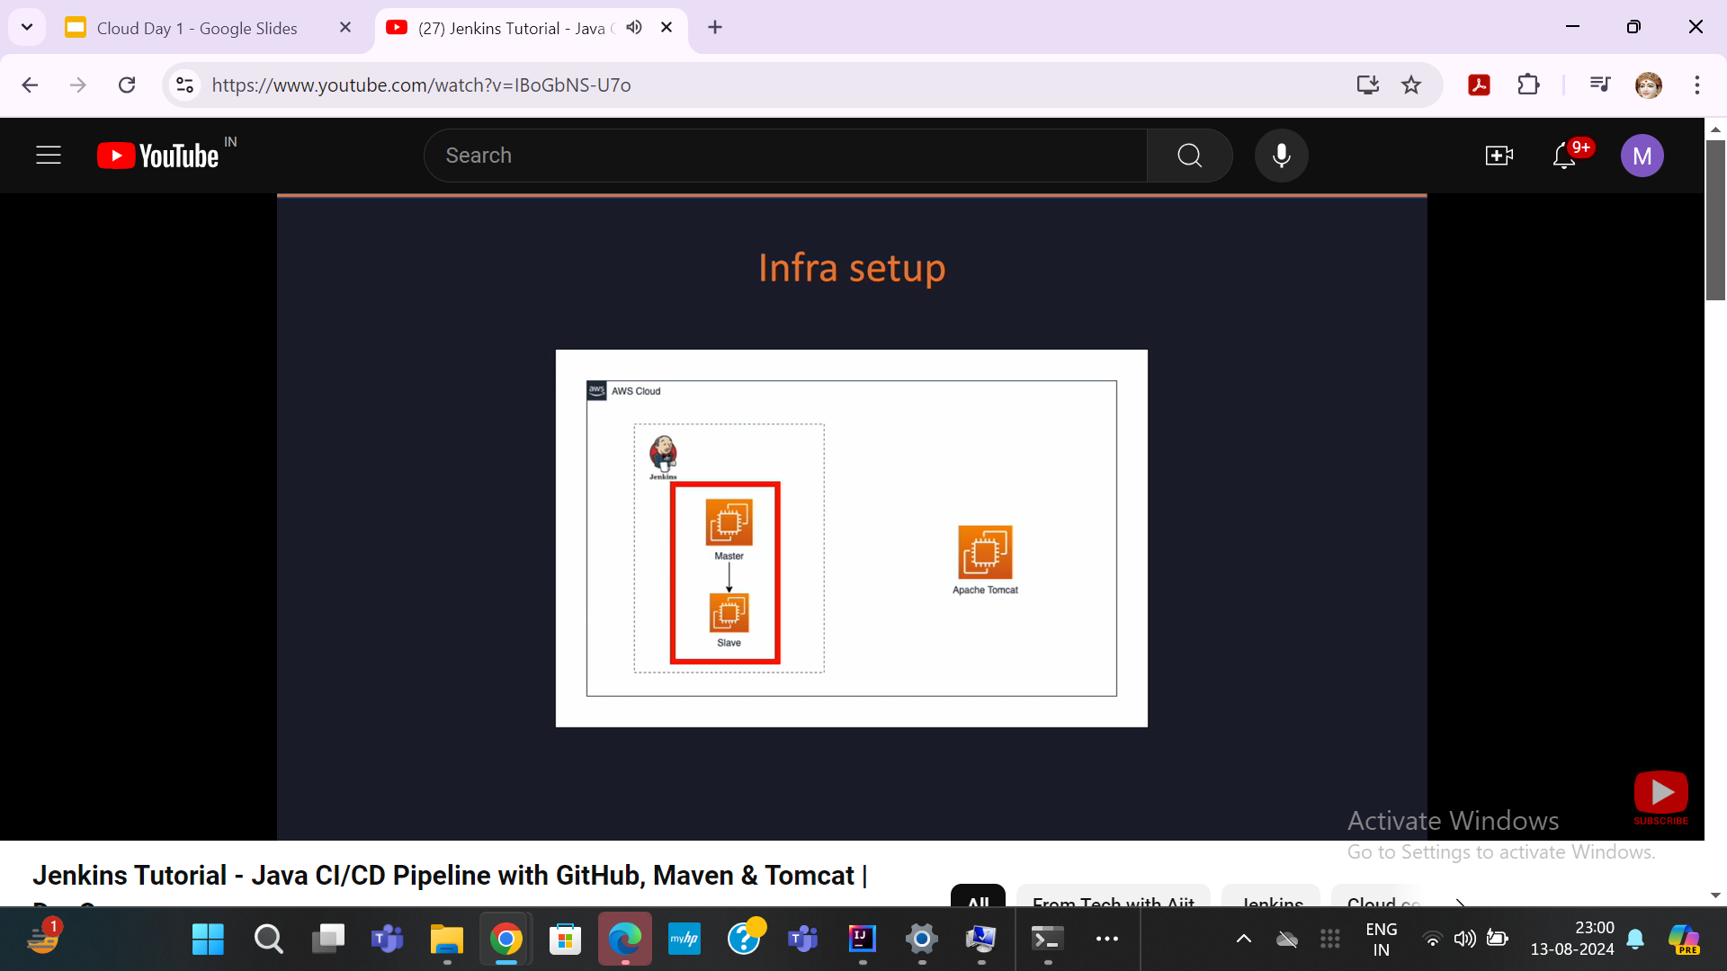

Slide 7
Tools for Continuous Integration
Continuous Integration (CI) is a practice in software development where developers regularly merge their code changes into a shared repository, which is then automatically tested and built. This helps catch issues early, ensures that the codebase is always in a deployable state, and speeds up the development process. Here are some popular tools used for Continuous Integration:
1. Jenkins
Description: Jenkins is an open-source automation server that is highly customizable and supports a wide variety of plugins. It’s one of the most widely used CI tools.
Key Features:
Wide range of plugins for different languages, SCMs, and build tools.
Strong community support.
Easily extensible with custom scripts.
Use Case: Ideal for complex, multi-language, and multi-platform environments.
2.GitLab CI/CD
Description: GitLab CI/CD is integrated into GitLab and offers seamless CI/CD pipelines with the GitLab repository.
Key Features:
Fully integrated with GitLab.
Supports auto-scaling, parallel execution, and Docker containers.
Visual pipeline editor and strong reporting tools.
Use Case: Best for teams already using GitLab for source control.

Slide 8
Tools for Continuous Integration
CircleCI
Description: CircleCI is a cloud-based CI tool that supports fast and flexible CI/CD pipelines.
Key Features:
Supports Docker and allows for caching dependencies to speed up builds.
Provides insights and analytics on build performance.
Flexible configuration through YAML.
Use Case: Great for teams looking for a cloud-first solution with strong Docker support.
Travis CI
Description: Travis CI is a cloud-based CI tool that integrates with GitHub and Bitbucket. It’s popular among open-source projects.
Key Features:
Simple setup with minimal configuration.
Strong integration with GitHub.
Free for open-source projects.
Use Case: Ideal for open-source projects or small to medium-sized teams using GitHub.

Slide 9
Tools for Continuous Integration
Bamboo
Description: Bamboo is an Atlassian product that integrates seamlessly with other Atlassian tools like Jira and Bitbucket.
Key Features:
Strong integration with Atlassian ecosystem.
Supports parallel builds and deployment projects.
Built-in Git branching workflow support.
Use Case: Best for teams heavily invested in the Atlassian ecosystem.
6. TeamCity
Description: TeamCity is a CI tool developed by JetBrains, known for its robust build management and integration with various development tools.
Key Features:
Comprehensive support for build configuration and templates.
Strong integration with JetBrains IDEs like IntelliJ IDEA.
Advanced build chain dependencies and parallelism.
Use Case: Suitable for teams using JetBrains IDEs or looking for advanced build management capabilities.

Slide 10
Tools for Continuous Integration
Azure DevOps (formerly VSTS)
Description: Azure DevOps provides a complete CI/CD pipeline integrated with Azure services.
Key Features:
Integrated with Azure cloud and other Microsoft services.
Supports YAML-based pipelines.
Extensive monitoring and reporting tools.
Use Case: Ideal for teams developing within the Microsoft and Azure ecosystem.
8. GitHub Actions
Description: GitHub Actions allows you to automate, customize, and execute software development workflows directly in your GitHub repository.
Key Features:
Native to GitHub with a deep integration.
Supports Docker containers, matrix builds, and self-hosted runners.
Marketplace with pre-built actions for common tasks.
Use Case: Best for GitHub-centric workflows and those looking for tight integration with GitHub.

Slide 11
Tools for Continuous Integration
Bitbucket Pipelines
Description: Bitbucket Pipelines is a CI/CD service built into Bitbucket, offering an integrated solution for teams using Bitbucket repositories.
Key Features:
Integrated with Bitbucket repositories.
Easy setup with YAML configuration.
Supports Docker containers and parallel steps.
Use Case: Perfect for teams using Bitbucket for version control.
10. AWS CodePipeline
Description: AWS CodePipeline is a continuous integration and delivery service for fast and reliable application updates.
Key Features:
Deep integration with AWS services.
Fully managed and scalable.
Supports a variety of third-party tools for testing and deployment.
Use Case: Best for teams building and deploying on AWS.

Slide 12
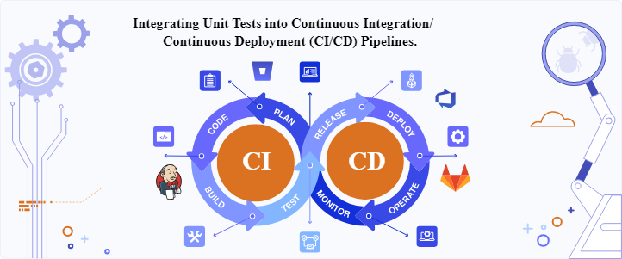
Integration

Slide 13
What is Continuous Integration/Continuous Deployment?
Continuous Integration (CI) involves developers integrating their code changes into a central repository multiple times daily. This practice triggers automated build and test processes for the project with each code change, ensuring the stability and correctness of the codebase.
The primary goal of CI is to identify and address integration errors and conflicts early in the development process, facilitating smoother collaboration among team members.
By promoting frequent integration of code changes, CI reduces the likelihood of conflicts between different code branches and ensures that the entire team is working with the latest version of the codebase.
Moreover, CI enables rapid feedback loops, allowing developers to receive immediate notifications about the status of their code changes and address any issues promptly. This quick feedback mechanism helps maintain the overall stability and reliability of the software.

Slide 14
Integration
Continuous Deployment (CD) takes the principles of CI a step further by automating the process of deploying code changes to production environments.
Once code changes have passed all necessary tests and quality checks in the CI pipeline, they are automatically deployed to production servers without human intervention. CD enables organizations to release software updates more frequently and reliably, enhancing their agility and responsiveness in the software development process. By automating the deployment process,
CD facilitates rapid iteration cycles, allowing organizations to release new features, bug fixes, and improvements to users in real-time. Additionally, Continuous Deployment fosters a culture of continuous improvement and learning within development teams. With each deployment, developers receive immediate feedback from users, enabling them to gauge the impact of their changes and make adjustments accordingly.

Slide 15
Developers integrate code changes into a central repository multiple times daily.
Automated build and test processes are triggered for the project with each code change.
CI promotes frequent integration of code changes, reducing conflicts and ensuring team collaboration.
Rapid feedback loops enable developers to address issues promptly, maintaining software stability.
CD automates the deployment of code changes to production environments.
It enables quicker and more frequent software releases, enhancing agility and responsiveness.
CD fosters a culture of continuous improvement and learning within development teams.
Immediate feedback from users allows for iterative enhancements and adjustments.

Slide 16
What is Code Coverage?
Code Coverage is a metric used in software development to represent the extent to which an application’s source code is executed while a test suite is run. To see and evaluate the code coverage of a software application, a report is produced. Then, code quality may be ensured using this code coverage report.
The JaCoCo-Maven plugin is used to generate code coverage reports. Source code with high code coverage has more of its code executed during testing. For example, if the software you are testing contains 100 lines of code and the number of code lines validated in the software is 90, then the code coverage percentage of that software application will be 90%.

Slide 17
Benefits of Code Coverage
Code coverage is a very useful metric for developers, testers, and QA engineers. Here are some of the salient benefits of code coverage:
Code coverage reports provide useful insights in detection and elimination of dead code. This can be avoided by following implementation best-practices which in turn results in improved code maintainability and better product quality.
Quality assurance can help detect code that has not been covered using the test implementation.
Developers can finish the software development process faster, increasing their productivity, scalability, and efficiency. This results in reduced Time to Market (TTM).

Slide 18
What is JaCoCo-Maven Plugin?
JaCoCo-Maven (abbreviation for Java Code Coverage) plugin is an open-source code coverage tool for Java. It creates code coverage reports and integrates well with IDEs(Integrated development environments) like Eclipse IDE.
It also integrates smoothly with CI/CD tools (e.g. Jenkins, Circle CI, etc.) and project management tools (e.g. SonarQube, etc.). It is a part of the Eclipse Foundation and has replaced the EclEmma code coverage tool in Eclipse.

Slide 19
How does JaCoCo-Maven Plugin work?
The JaCoCo-Maven plugin runs the coverage by instrumenting Java code through a runtime agent. In simple terms, you attach this agent to a JVM (Java Virtual Machine) when it starts. This agent is termed as JaCoCo agent. The first execution start-agent starts this JaCoCo Runtime Agent.
Whenever a class is loaded, JaCoCo can instrument the class so that it can view when the class is called and what lines (of code) are called during the testing process. By keeping this track, it builds up the code coverage statistics which is done on the fly during the second execution (i.e. generate-report).
By default, the file is created as soon as the JVM terminates but it is also possible to run the agent in server mode. This triggers a dump of the results and the report is created before the termination. Shown below are the internals of the JaCoCo plugin:

Slide 20
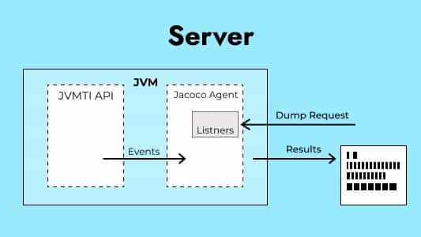

Slide 21
Configurations
You can define goals and rules in the configuration of the JaCoCo-Maven plugin. This offers you the flexibility to set limits and helps in checking the amount of code coverage.
Maven-surefire plugin is the default Maven plugin. This runs the tests in JVM and provides coverage reports. While the JaCoCo plugin instruments the code already executed by a plugin (e.g. Surefire plugin). Thus, it is a good practice to check for the dependency of the maven-surefire plugin.

Slide 22
Why is Jacoco Maven Plugin good for code coverage?
The JaCoCo-Maven plugin is appropriate for code coverage because of the following reasons:
While working on any project, developers mostly prefer IDEs because it simplifies the coding and testing experience. JaCoCo can be installed on Eclipse IDE in the name of EclEmma, by downloading EclEmma from its marketplace.
It is easy to add the JaCoCo plugin to all types of builds, including ANT, Maven, and Gradle. It can also be integrated with CI/CD tools like Jenkins, Circle CI, etc. This makes it versatile for a lot of use cases.
The code coverage report generated by JaCoCo is a simple and informative HTML file that can be viewed in any browser or IDE.
JaCoCo also provides offline instrumentation (i.e., all the classes are instrumented before running any tests).
Analysis of a report is also quite easy, as it is color-based and provides the exact percentage of code coverage.

